Slide 1

[Samsung PRISM] Preliminary Discussion
Multi-View Segmentation ​ &​ Assisted Correction of Images​
Team
College Professor(s): Dr. Prakash K. Aithal / prakash.aithal@manipal.edu
Dr. Muralikrishna S. N. / murali.sn@manipal.edu
Students:
A S Aravinthakshan/ aravinthakshanmain@gmail.com
Janak Shah/ janak.sh41@gmail.com
Kavya Bansal/ kavyabansal20904@gmail.com
Prasanna/ prasannabhat345@gmail.com
Department: CSE
Date: 24/01/25

Slide 2

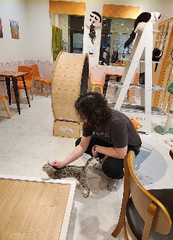
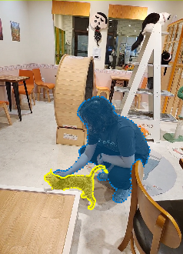
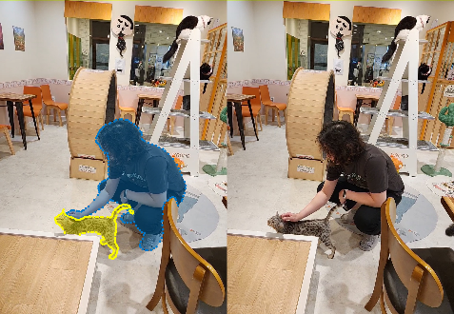
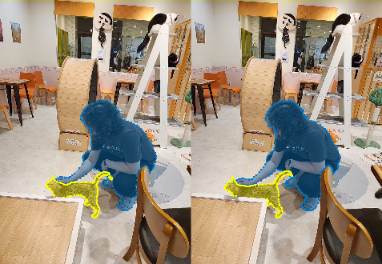






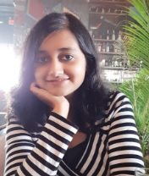
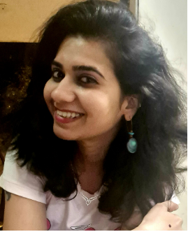
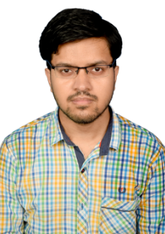
Work-let Area – Computer Graphics|A software tool to generate Multi-view Image Segmentation & Correction
Work-let expected duration – 6 months.
Problem Statement:
Image Segmentation is a technique of partitioning a digital image (or video frames) into multiple groups, based on similar characteristics. This requires high quality point-wise boundary annotation for object segments, for training DNN-based segmentation models. This annotation process is manual and time taking.
If a scene is captured from different viewpoints, each view point image needs to be segmented and labelled individually.
Goal is to develop a web-based annotation tool, hosted on Linux server, to generate the segmentation in multi-view images automatically, including interactive correction.
Web-based Annotation Tool with Correction Methodology:
Module 1: Given an image, generate manual annotation by creating point-based polygons, and assign suitable labels.
Module 2: Given a manually segmented image and other images of same scene from different views as inputs, automatically generate the segmented images for all the views.
Module 3: Given an already segmented image, support Interactive Correction, which is a click-based interactive refinement, for correcting the segmentation mask in case of both false positives and negatives.
Basic functionalities to be supported: browse folder, previous image, next image, create polygon, edit polygon, create segmentation, add segment and remove segment.
Open source DL based models can be plugged-in at the backend for multi-view image segmentation and interactive correction.
Scope includes creation of a small multi-view image dataset for testing the functionality of the tool.
References:
https://github.com/labelmeai/labelme
https://github.com/gap-lab-cuhk-sz/mvimgnet
CVAT
Expectations
Module 1
Module 2
Module 3
Addition
Removal
Addition
Kick Off < 1st Month >
Problem definition, scoping
Understanding the requirements
Basic design of the web based tool for segmentation annotation (Linux based, hosted on server)
Use of open-source DNN models for multi-view image segmentation and interactive correction.
Milestone 1 < 2nd & 3rd Month >
Development of Module 1 feature of the automation tool , along with functionalities for browse folder, previous image and next image.
Creation of multi-view image dataset for testing.
Finalizing the open-source DNN models
Milestone 2 < 4th Month & 5th Month >
Development of Module 2 and Module 3 features of the automation tool
Individual testing of each module
Closure < 6th Month >
Final verification of entire system/tool together and testing.
Shreyasi Das
shreyasi.das@samsung.com
Jyoti Johri
jyoti.johri@samsung.com
Shouvik Das
shouvik.das@samsung.com
Notes:
-

Slide 3
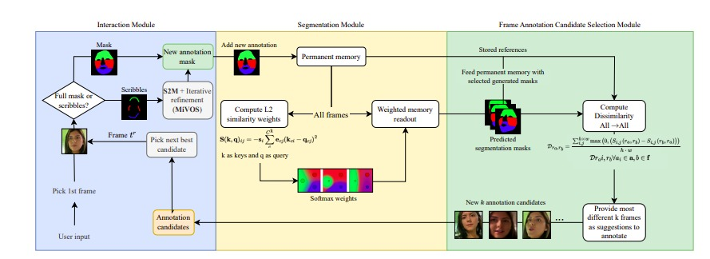
Progress
Overview of model architectures provided, is gone through thoroughly. The workflow of XMem++, RITM and LabelMe has been completely understood
React UI for multiview and Polygon points based correction has been implemented
The model architecture workflow has been designed along with the feedforward mechanism
Timeline of progress has been made.
GitHub Repo Link: https://github.com/codegallivant/autosegmenter-webapp

Slide 4
Timeline
Tasks for the upcoming week (By 31 Jan):
Get a working implementation of just XMem++ Integrated with labelme for rapid prototyping ( the react web app with necessary components will slowly be built over time )
XMem++: Production-level Video Segmentation From Few Annotated - https://max810.github.io/xmem2-project-page/, https://arxiv.org/pdf/2307.15958
Tasks for next two weeks (7 Feb):
Get the complete model pipeline ritm_interactive_segmentation for interactive correction fed back to XMem++.
React UI with multiple polygon selection and label allocation to be done.
Tasks for next 5 weeks (28 Feb):
Create complete mimic of LabelMe in React UI

Slide 5
Queries
Challenges :
(Discuss in the form of bullets, what are the next action steps, any road blocks / bottlenecks)
Can we use different languages/frameworks slightly deviating from Django/ReactJS? As we will be mimicking Python based LabelMe in ReactJS.

Slide 6
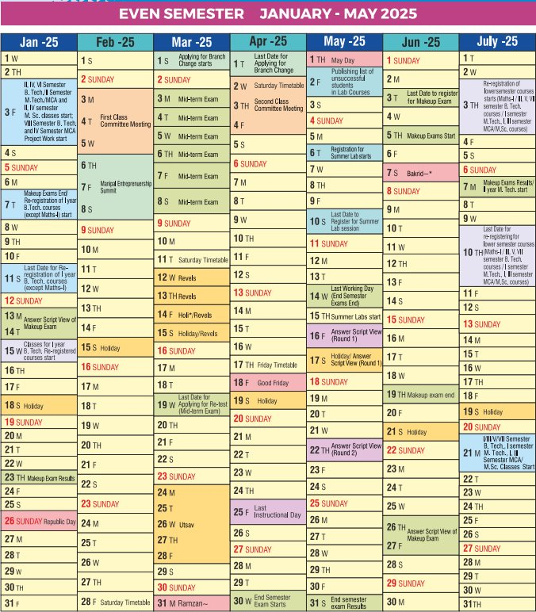
Academic Calendar Breaks
Exams/Internals
Mid-term exams - 03/03/25 to 08/03/25
Mid-term re-test(tentative) - 04/04/25 to 25/04/25
End-semester exams - 30/04/25 to 14/05/25
End-semester makeup – 05/06/25 to 19/06/25
Lab-end-semester exams(tentative)- April 1st week to 2nd week.
Holidays/Events
Manipal entrepreneurship summit – 06/02/25 to 08/02/25
Revels (MIT cultural event) - 12/03/25 to 15/03/25
Utsav (MAHE cultural event) - 24/03/25 to 28/03/25
Ramzan – 31/03/25
May day – 01/05/25
Semester break – from 14/05/25
Our Academic Calendar

Slide 7
Professor Comments
Slide to be filled in by professor (Either of two)
Proposed monthly progress approach: One monthly meeting with Samsung Prism
Latest paper reviewed regarding the problem statement area: Will Start as well as engage students
Professor Expert Insights: We thought it as normal project. Muralikrishna Sir and Myself know computer vision and our next HOD Sir is also from same domain. Professors and students will work together towards the successful completion of the research project.

Slide 8
Thank you

